Slide 1
MEETING LIFE CHALLENGES
CLASS XII

Slide 2
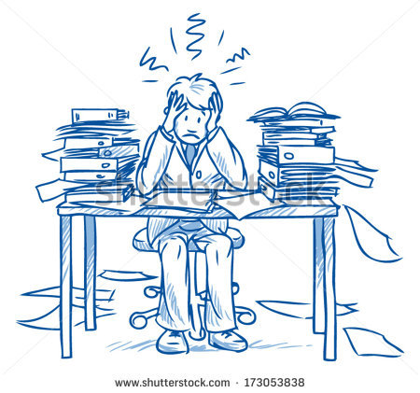
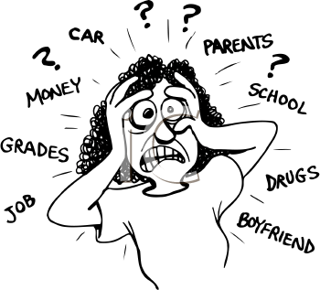
WHAT DO YOU UNDERSTAND FROM THESE PICTURES????????

Slide 3
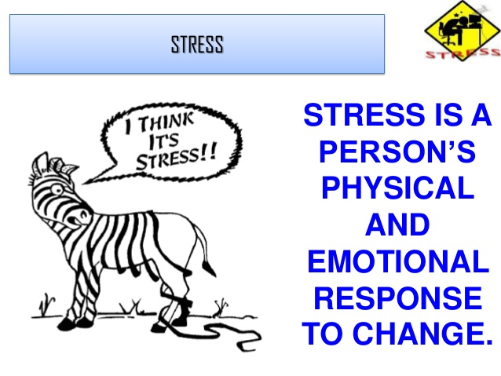
WHAT IS STRESSSSS???????????

Slide 4
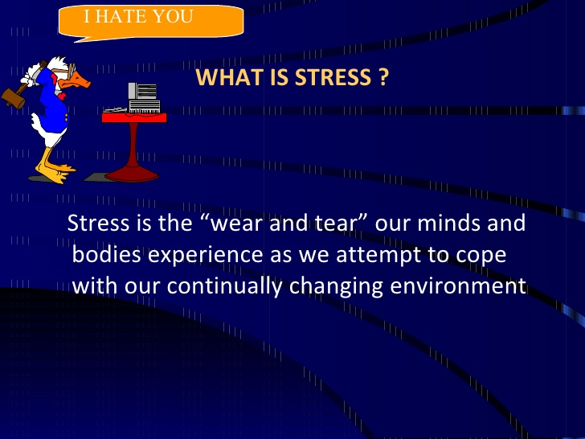
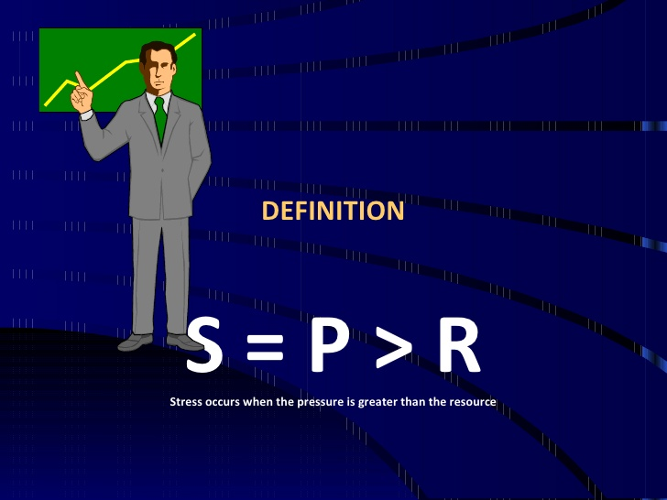

Slide 5
TWO DIMENSIONS OF STRESS
EUSTRESS - GOOD FOR ANY PERSON AND ACTS AS AN ASSET FOR ACHEIVEING PEAK PERFORMANCE AND MANAGING MINOR CRISIS.
DISTRESS – WHEN STRESS HAS NEGATIVE EFFECTS SUCH AS CONFUSION, INABILITY TO TAKE DECISIONS AND ILLNESS. IT CAUSES OUR BODY’S WEAR AND TEAR.

Slide 6
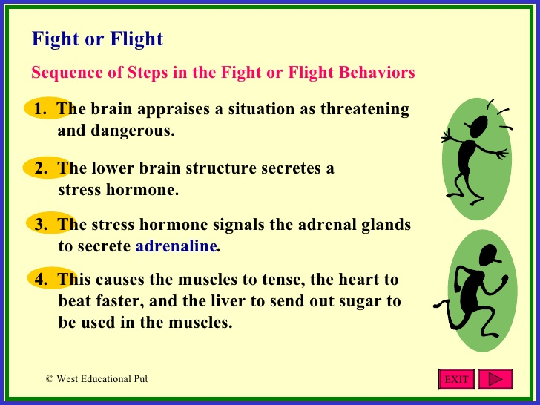

Slide 7
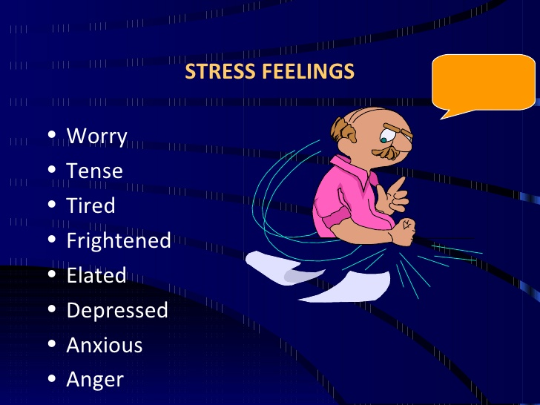

Slide 8
SYMPTOMS
PHYSICAL
PSYCHOLOGICAL
EMOTIONAL

Slide 9
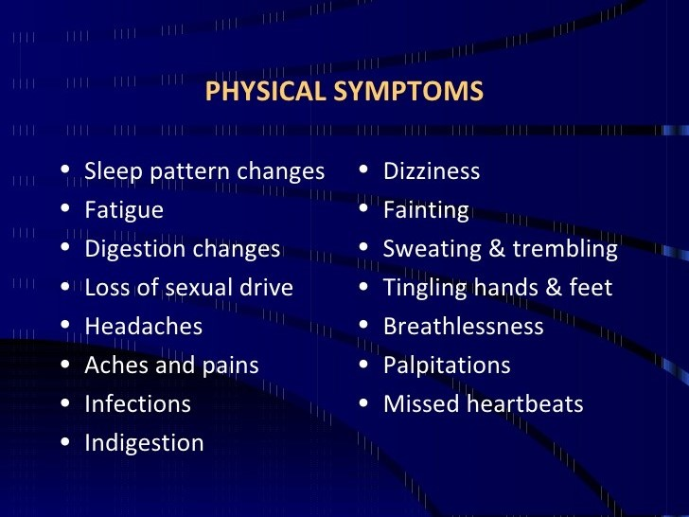
PHYSICAL SYMPTOMS

Slide 10
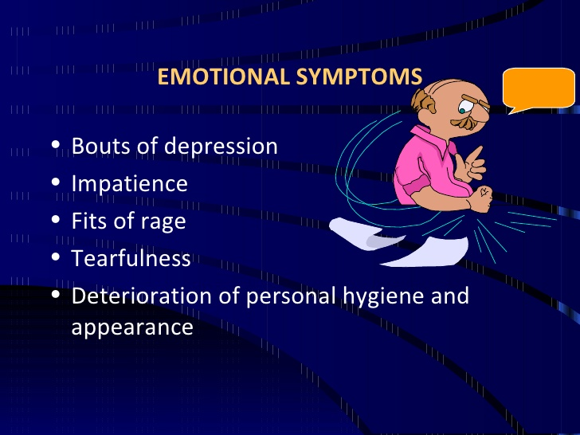
EMOTIONAL SYMPTOMS

Slide 11
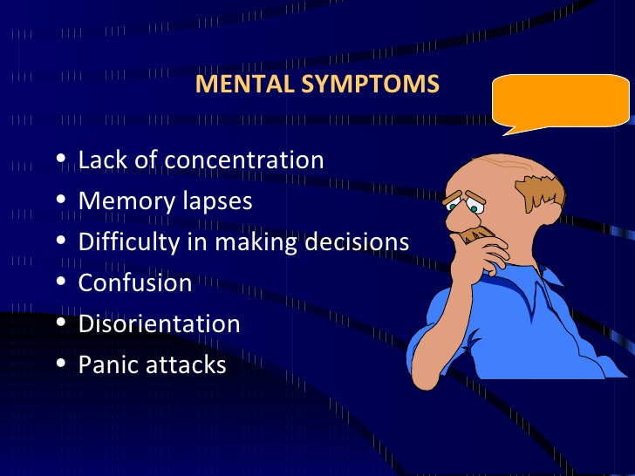
PSYCHOLOGICAL SYMPTOMS

Slide 12
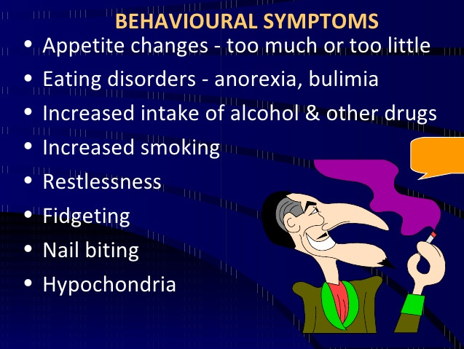

Slide 13
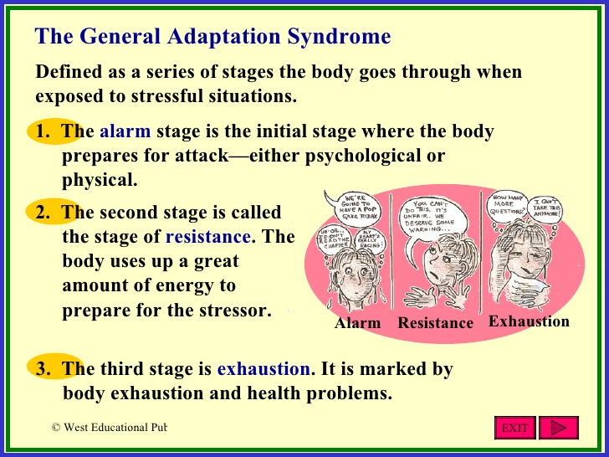
GAS MODEL

Slide 14
TYPES OF STRESS
There are three types of stress-
Physical and Environmental stress
Psychological stress
Social stress

Slide 15
PHYSICAL AND ENVIRONMENTAL STESS
Physical stresses are demands that change the state of our body. Example - overexert ourselves physically, lack of nutrients or fail to get enough sleep etc.
Environmental stresses are the aspects of our surroundings that are unavoidable such as air pollution, crowding, noise, heat, disasters etc.

Slide 16
PSYCHOLOGICAL STRESS
These are stresses that we generate ourselves in our mind.
Personal and unique to the experiencing person and are internal sources of stress.
Frustration Conflicts
Internal pressures Social pressures

Slide 17
Effects
Emotional
Physiological
Cognitive
Behavioural

Slide 18
COPING WITH STRESS
COPING is a dynamic situation specific reaction to stress. Concrete responses to resolve the problems and reduces stress.
The three coping strategies given by ENDLER and PARKER are-
TASK ORIENTED
EMOTION ORIENTED
AVOIDANCE ORIENTED

Slide 19
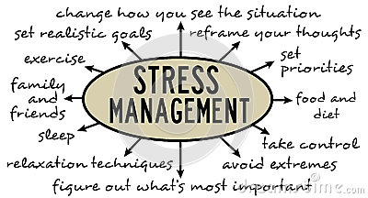

Slide 20
THANK YOU…….

